Slide 1
2- Get Start Scratch
Teacher: Wei Sun

Slide 2
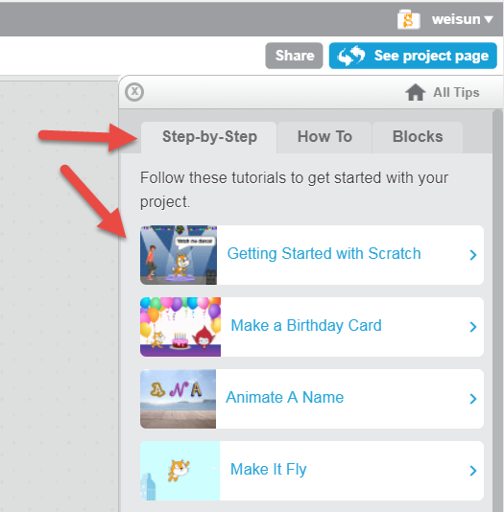
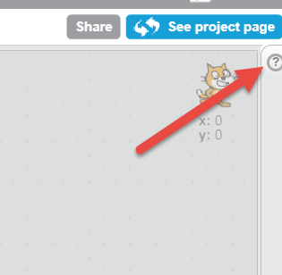
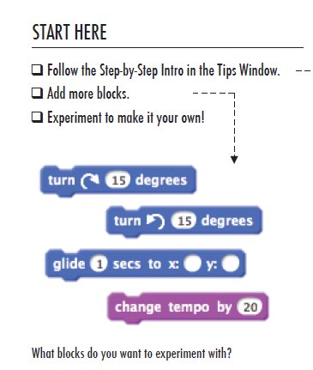
Follow the Scratch help --StepbyStep

Slide 3
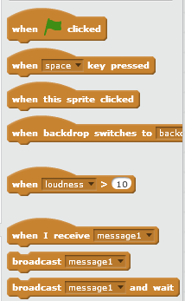
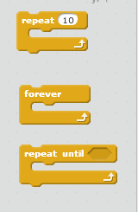
Example scratch scripts -1
Demo with \Scratch2StarterProjects\Animation\Animate the Crab.sb2
“When” Events
“forever” Loop

Slide 4
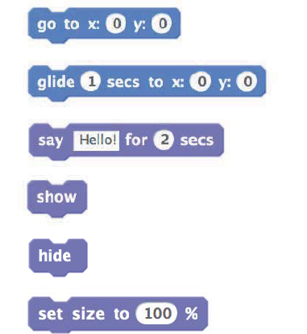
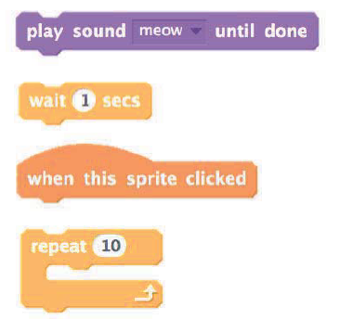
Play with 10 blocks
What Can you create with only 10 scratch blocks? (pdf: 10 blocks.pdf)

Slide 5
Make a About me
Option 1
Chose a background/stage
Draw your self, when click say something
Animate Your Name
Couple your favorite objects or items
… more

Slide 6
Make a About me
Option 2
Chose a background/stage
Add background music
Draw your self, animate your self
When tap space, hide previous item and show next item
… more

Slide 7
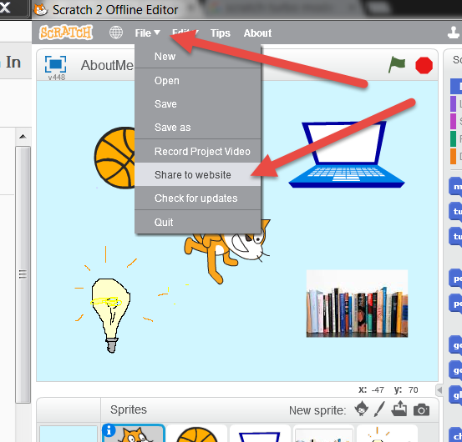
Share you project -Upload your project to website

Slide 8
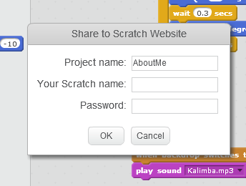
Share you project -input your scratch username and password

Slide 9
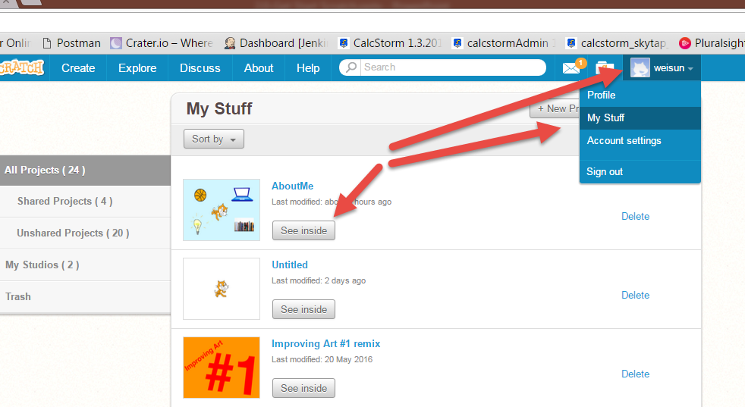
Share you project -login scratch.mit.edu, and find your uploaded project

Slide 10
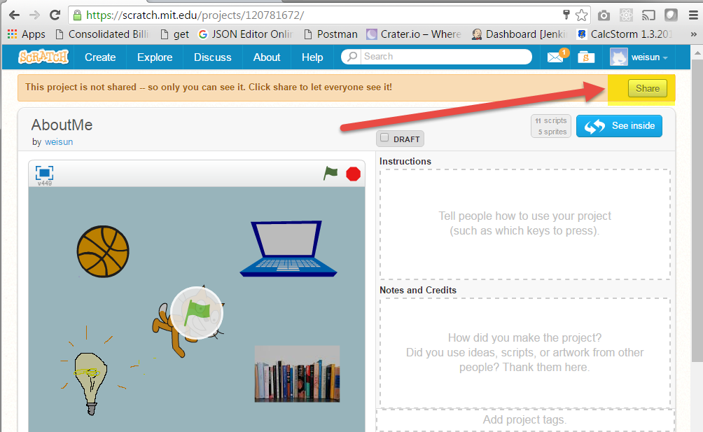
Share you project -open the project, click share

Slide 11
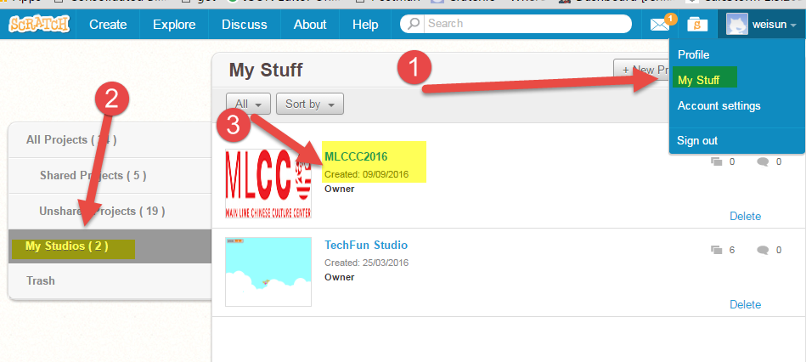
Share you project -go to my Studios-> MLCCC2016

Slide 12
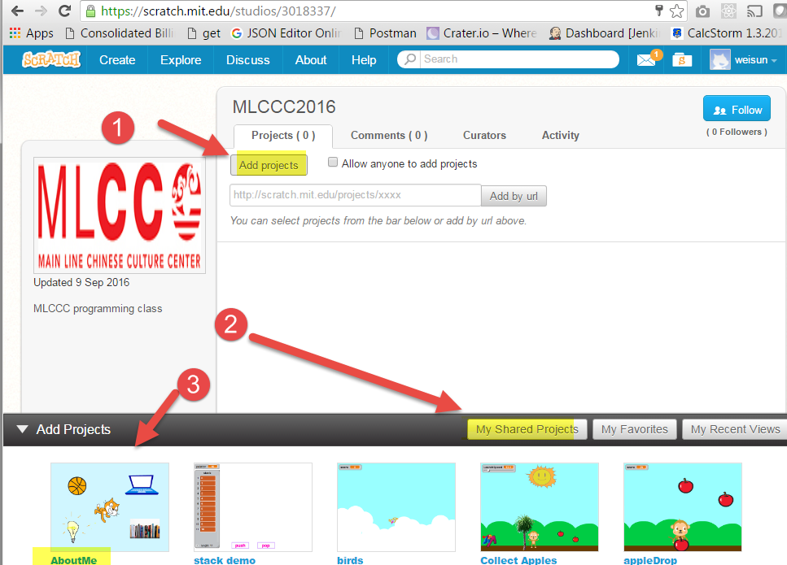
Share you project -Add project to MLCCC2016 studio

